Slide 1
Legend
Standard function
Optional function
Global input data
Global output data
Intermediate i/o data
Minimum allowed corridor, ids of denylisted triangle chains (edges)
fcn_MedialAxis_makeCostGraphAndAllPoints
Adjacency matrix, cost matrix, all points table, start data structure, finish data structure, best triangle chain (edge) between each pair of nodes
2D polytopes defined as vertices,
Triangulation resolution
Throughout this slide deck, this flow chart of the medial axis planning stack will be referenced. Each section explaining theory behind a function will be introduced by showing the chart with the function to be explained highlighted in color while the remaining functions are grayed out.
fcn_MedialAxis_makeAdjacencyMatrixAndTriangleChains
Adjacency matrix, triangle chains (edges), nodes
fcn_algorithm_astar
Route (as series of nodes)
fcn_MedialAxis_pruneGraph
fcn_MedialAxis_processRoute
Adjacency matrix, triangle chains (edges), nodes (all without dead ends and “through nodes”)
Route (as series of points), route length, narrowest corridor in route
fcn_MedialAxis_addCostsToTriangleChains
Triangle chains (edges) now with lengths and corridor widths
Start position, finish position
Adjacency matrix, triangle chains (edges), nodes, triangle and node closest to start, triangle and node closest to finish
fcn_MedialAxis_addPointToAdjacencyMatrixAndTriangleChains

Slide 2
To increase path diversity, instead of planning with a visibility graph, planning can involve searching a Voronoi diagram. This is because a Voronoi diagram can be formed such that there is one line per corridor rather than several.
Example visibility graph (only showing interior lines)
Example Voronoi diagram (only showing interior lines)

Slide 3
The Voronoi diagram takes in a set of points and returns cells where each cell contains the region closest to that point than any other point. The boundaries of the cells are thus the lines running between the points that are as far as possible from neighboring points.
Example Voronoi diagram (only showing interior lines)

Slide 4
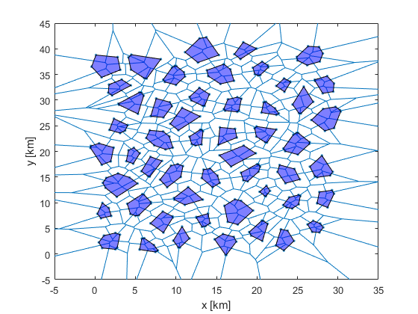
Forming a Voronoi diagram from the vertices of convex obstacles yields cell boundaries useful for planning, where each cell boundary represents the center of a corridor.

Slide 5
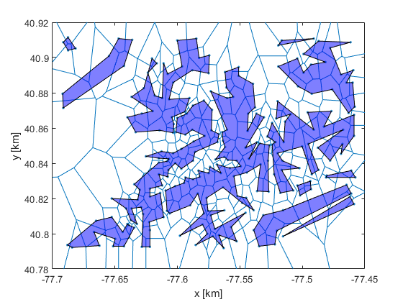
However, if the same task is performed for nonconvex fields, there are corridors with no Voronoi edge.

Slide 6
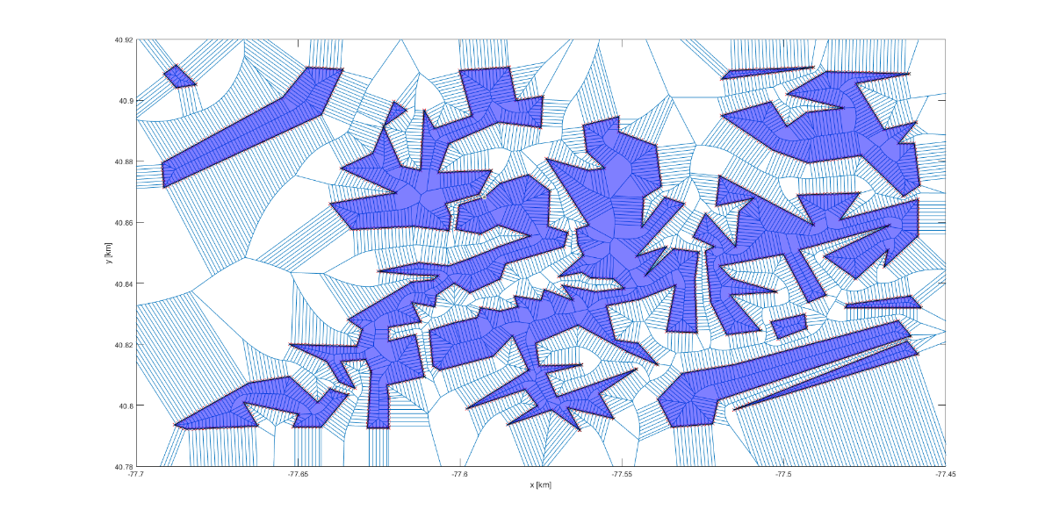
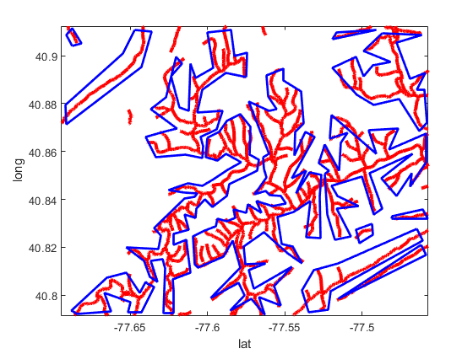
It is worth noting that in our group “Voronoi diagram” refers to two very different things based on the same geometric structure.
The Voronoi diagram formed around the Halton set used to CREATE polytopes
The Voronoi diagram formed around the polytopes in free space, CREATED FROM polytopes
Use Voronoi boundary as polytopes
Take Halton point set
Form Voronoi around points
Form Voronoi around obstacle bounds
Start with polytopic obstacles that may or may not be generated from a Voronoi diagram

Slide 7
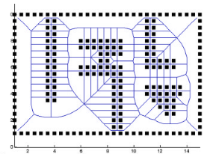
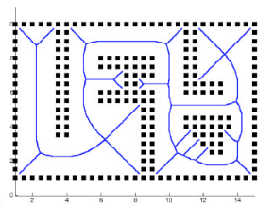
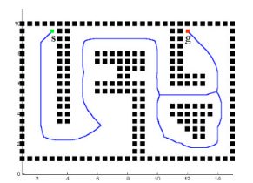
Masehian et al. have a method to address this where the Voronoi diagram is found from many points inside an obstacle, rather than just the vertices.
1. Find Voronoi diagram from many points within obstacle.
2. Remove Voronoi cell boundaries that cross obstacles.
3. Remove dead ends.
Masehian, Ellips, and M. R. Amin‐Naseri. "A voronoi diagram‐visibility graph‐potential field compound algorithm for robot path planning." Journal of Robotic Systems 21.6 (2004): 275-300.

Slide 8

We can apply a similar method by interpolating polytope side with vertices. As long as every side has at least one intermediate vertex, the corridors in the obstacle field will have Voronoi cell boundaries.

Slide 9
The next step is to remove the cell boundaries that cross obstacle sides and do not add traversable corridors.

Slide 10
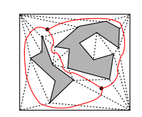
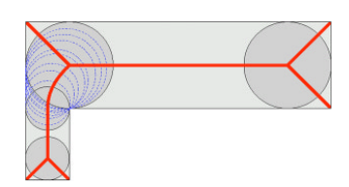
There may be an easier way to calculate the Voronoi diagram between the nonconvex polytopes using Delaunay triangulation. The centers of the free space triangles can be connected in a graph [1] that approximates the medial axis or the centers of the maximally inscribed disks [2].
The medial axis formed from the centers of the disks
Maximally inscribed disks in a corridor
[1]
[2]
A graph connecting Delaunay triangles
[1] Chen, Danny Z., and Haitao Wang. "A new algorithm for computing visibility graphs of polygonal obstacles in the plane." Journal of Computational Geometry 6.1 (2015): 316-345.
[2] Masehian, Ellips, and M. R. Amin‐Naseri. "A voronoi diagram‐visibility graph‐potential field compound algorithm for robot path planning." Journal of Robotic Systems 21.6 (2004): 275-300.

Slide 11
Legend
Standard function
Optional function
Global input data
Global output data
Intermediate i/o data
Minimum allowed corridor, ids of denylisted triangle chains (edges)
fcn_MedialAxis_makeCostGraphAndAllPoints
Adjacency matrix, cost matrix, all points table, start data structure, finish data structure, best triangle chain (edge) between each pair of nodes
2D polytopes defined as vertices,
Triangulation resolution
fcn_MedialAxis_makeAdjacencyMatrixAndTriangleChains
Adjacency matrix, triangle chains (edges), nodes
fcn_algorithm_astar
Route (as series of nodes)
fcn_MedialAxis_pruneGraph
fcn_MedialAxis_processRoute
Adjacency matrix, triangle chains (edges), nodes (all without dead ends and “through nodes”)
Route (as series of points), route length, narrowest corridor in route
fcn_MedialAxis_addCostsToTriangleChains
Triangle chains (edges) now with lengths and corridor widths
Start position, finish position
Adjacency matrix, triangle chains (edges), nodes, triangle and node closest to start, triangle and node closest to finish
fcn_MedialAxis_addPointToAdjacencyMatrixAndTriangleChains

Slide 12
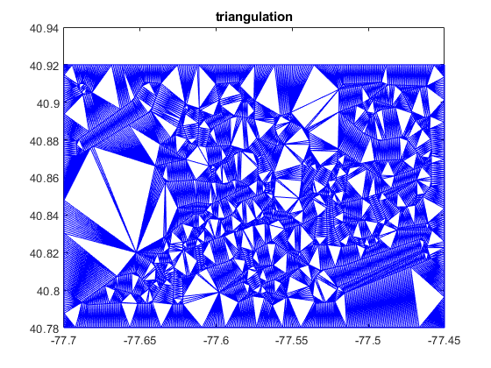
First, we form a Delaunay triangulation of the obstacle field so that every obstacle boundary is also a triangle boundary.

Slide 13
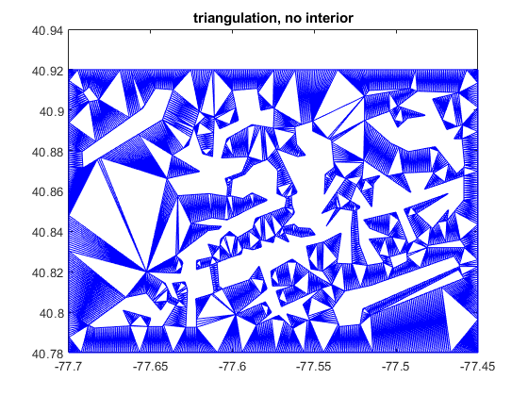
Next, triangles inside of polytope obstacles are removed.

Slide 14
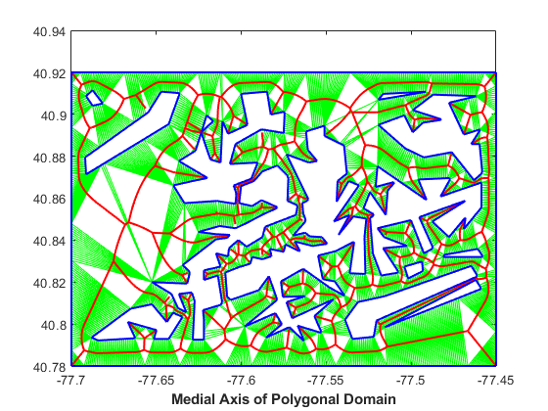
The circumcenters of the triangles can be found and their locations connected into a graph that approximates the medial axis of the free space.

Slide 15
One outstanding question was whether the incenter or circumcenter was appropriate to use. The circumcenter will have the advantage of always being in the triangles but it will oscillate as a rectangular corridor is approximated by triangles with alternating orientation.

Slide 16
The circumcenter gives a smoother approximate of the medial axis, with the accuracy improving as the triangle count increases.

Slide 17
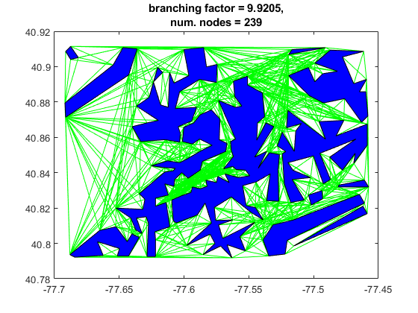
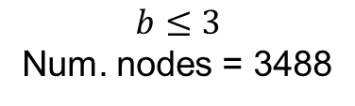
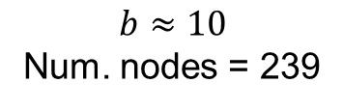
The high triangle count yields a smooth axis and a lowly connected graph (low branching factor, b), but the overall number of nodes in this graph is significantly higher than in a visibility graph.
Conventional vertex vgraph
Vgraph formed from medial axis
$$b≈10$$
Num. nodes = 239
$$b≤3$$
Num. nodes = 3488

Slide 18
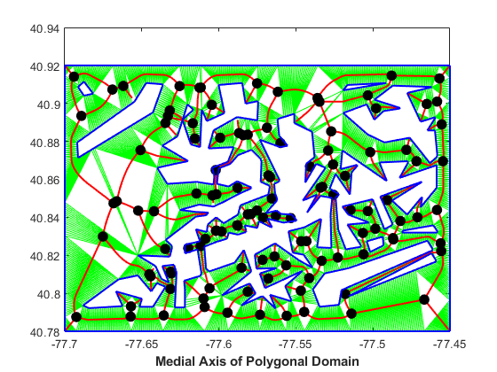
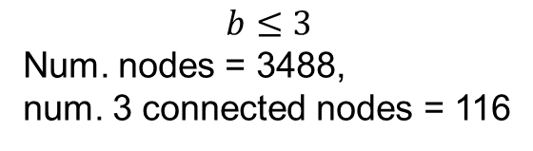
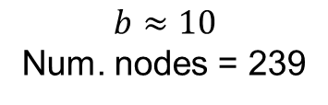
To work around this, we can keep only the 3-connected triangles as “nodes” in an adjacency graph (since the nodes may not be truly visible to each other).
$$b≈10$$
Num. nodes = 239
$$b≤3$$
Num. nodes = 3488,
num. 3 connected nodes = 116

Slide 19
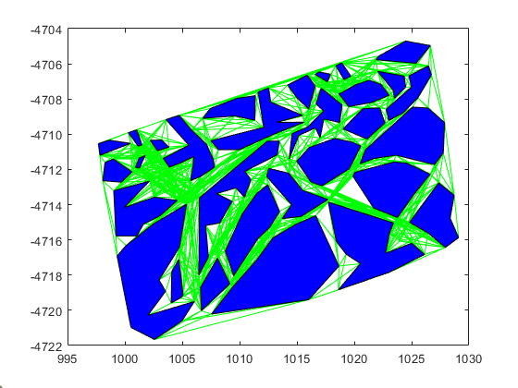
Once advantage about this graph is that every triangle has at most 3 neighbors, more commonly 2 neighbors for corridors. A* scales in time and memory as O(b^{d}) where d is path depth and b is branching factor, the average number of nodes connected to each node. Thus, assuming similar path depth, inputting the medial axis graph leads to better A* performance.
Conventional vertex vgraph
Vgraph formed from medial axis
$$b≈16.1$$
$$b≤3$$

Slide 20
Two nodes are adjacent if there exists a chain of 2-connected triangles between them.
For each three connected node:
while (not all three directions have been explored)
iterate through all 2 connected nodes in a direction until a 3 connected node or dead end is reached
if a dead end is hit
Continue
if a 3 connected node is reached
note that a path exists between 3 connected nodes i and j
note the chain of 2 connected triangles between i and j
$$b≤3$$
Num. nodes = 3488,
num. 3 connected nodes = 116

Slide 21
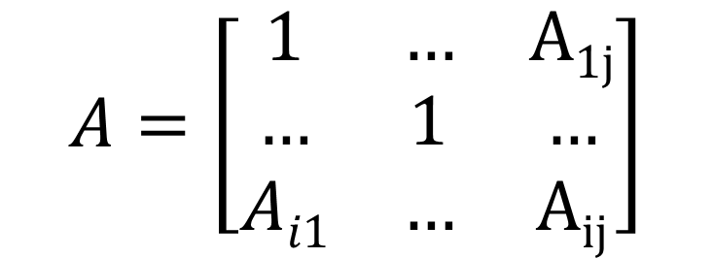
This yields two data structures. An adjacency matrix akin to the visibility matrix, indicating if node i has a path to node j. And a dictionary indicating the triangle chain between node i and j (called triangle_chains in code)
Starting triangle | Ending Triangle | Triangle Chain
i | j | [Tri_{i},…Tri_{n},…, Tri_{j}]
… | … | …
… | … | …
$$A=\left[\begin{matrix}1 & … & A1j \\ … & 1 & … \\ Ai1 & … & Aij\end{matrix}\right]$$

Slide 22
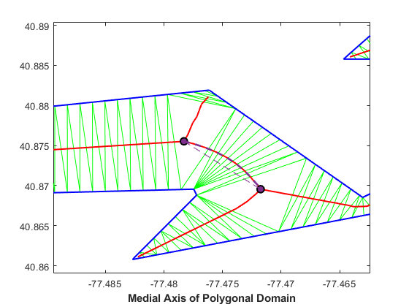
We can store the Boolean indicating that these nodes are connected as we would normally store visibility. However, the actual curved path between them will be stored in a look up structure.
Actual path between nodes
Connection between nodes exists

Slide 23
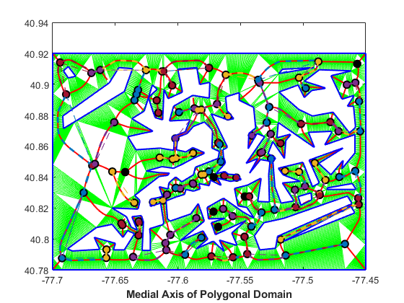
We can do this over an entire map relatively quickly (~1.5 s to triangulate and generated adjacency matrix and path segment dictionary for the map shown, compared to ~3.7 s for generating the conventional vgraph).

Slide 24
Legend
Standard function
Optional function
Global input data
Global output data
Intermediate i/o data
Minimum allowed corridor, ids of denylisted triangle chains (edges)
fcn_MedialAxis_makeCostGraphAndAllPoints
Adjacency matrix, cost matrix, all points table, start data structure, finish data structure, best triangle chain (edge) between each pair of nodes
2D polytopes defined as vertices,
Triangulation resolution
fcn_MedialAxis_makeAdjacencyMatrixAndTriangleChains
Adjacency matrix, triangle chains (edges), nodes
fcn_algorithm_astar
Route (as series of nodes)
fcn_MedialAxis_pruneGraph
fcn_MedialAxis_processRoute
Adjacency matrix, triangle chains (edges), nodes (all without dead ends and “through nodes”)
Route (as series of points), route length, narrowest corridor in route
fcn_MedialAxis_addCostsToTriangleChains
Triangle chains (edges) now with lengths and corridor widths
Start position, finish position
Adjacency matrix, triangle chains (edges), nodes, triangle and node closest to start, triangle and node closest to finish
fcn_MedialAxis_addPointToAdjacencyMatrixAndTriangleChains

Slide 25
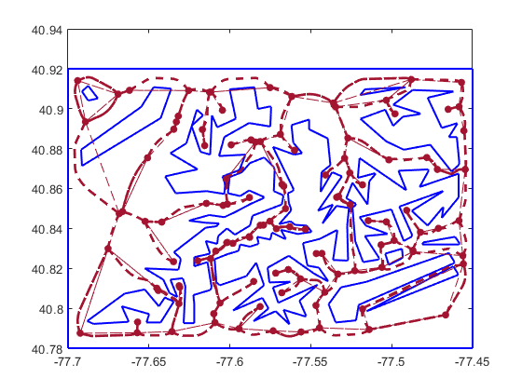
There are a couple modifications we can make to down sample the size of the resulting graph without losing information about corridors.
Removing nodes that don’t have branching choices
Removing dead end edges

Slide 26
First, there are nodes that were 3 connected to dead ends so when the dead end was removed they became 2 connected nodes. These can also be removed as they do not represent a planner choice. These are termed through nodes.

Slide 27
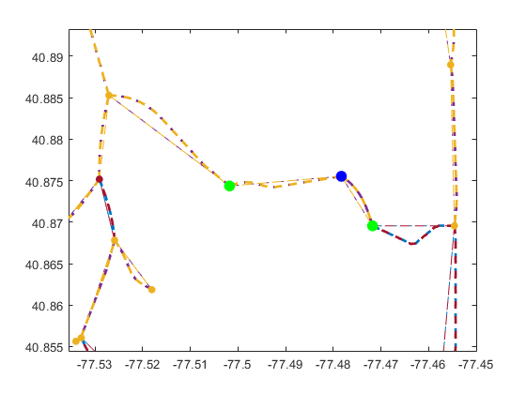
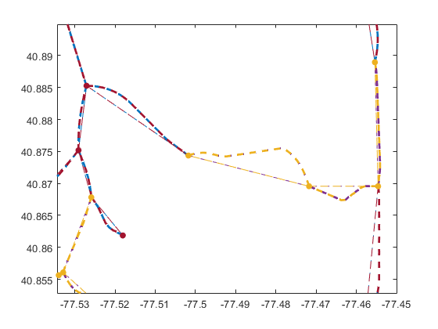
Here is an example of a through node being removed so its neighbors can be directly connected.

Slide 28
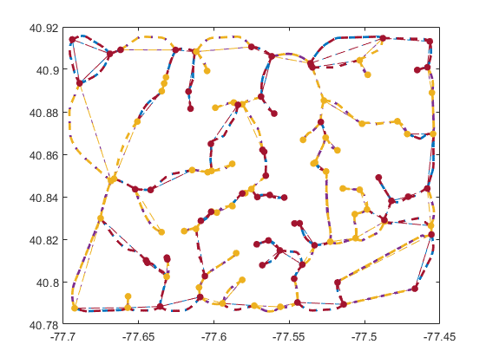
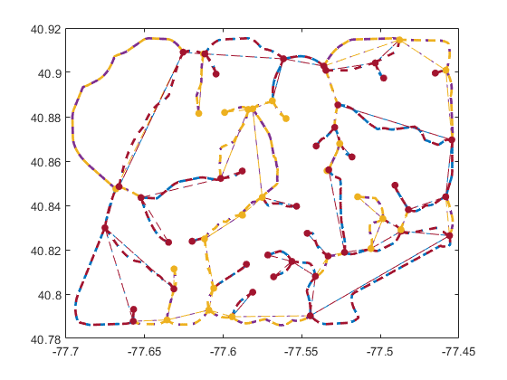
There are two ways to define a through node.The looser definition is that a through node has only two destinations. This means that only one edge between a pair of nodes will exist when the through nodes are removed.

Slide 29
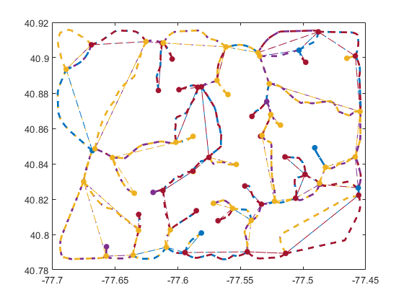
A more accurate definition is that a through node only has two departing paths rather than only two destinations. This preserves multiple paths between a given pair of nodes. This is desirable since each path may have a different corridor width or cost and the planner may therefore prioritize one over the other.

Slide 30
Next, there are dead end path segments left in this structure. These could be pruned however, the create access to parts of the map in culs-de-sac and therefore could be desirable for increasing the extent of where the planner can navigate.

Slide 31
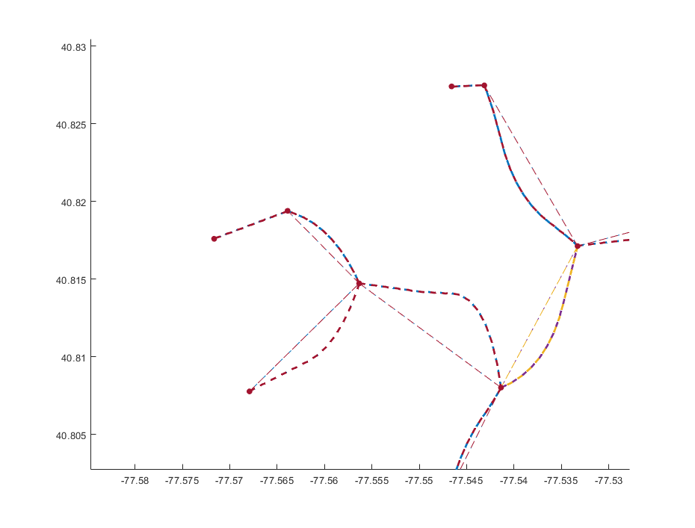
If it is desirable to remove dead ends, the through node removal must be performed before the dead end pruning otherwise one pass of dead end pruning will not remove the entire dead end.
1) If this dead end was pruned
2) It would create yet another dead end edge
3) Unless these nodes were removed first

Slide 32
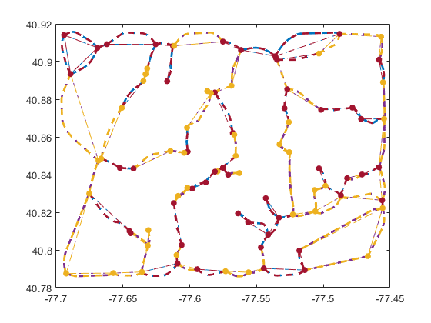
Here is a before and after of a one pass dead-end prune.

Slide 33
However, dead end removal can create new through nodes so through nodes have to be removed after dead end pruning.
1) If this edge was pruned
2) It would turn this node with 3 departing paths into a through node with 2 departing paths

Slide 34
Thus the algorithm must recurse until the graph converges.
Prune dead ends, possibly creating through nodes
Check for convergence between graph at cycle i and cycle i-1
Remove through nodes, thus consolidating dead ends
If convergence
Return minimum graph

Slide 35
These are the stages in practice:
1) Remove through nodes

Slide 36
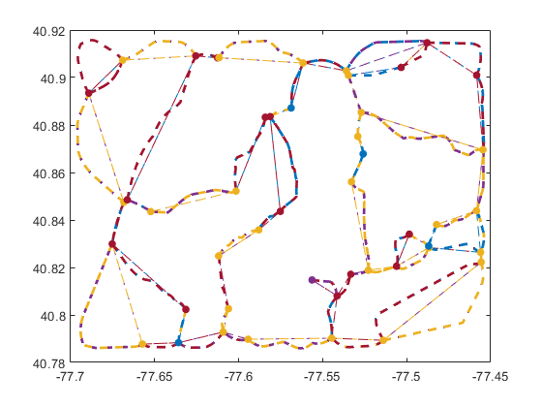
These are the stages in practice:
1) Remove through nodes
2) Remove dead ends

Slide 37
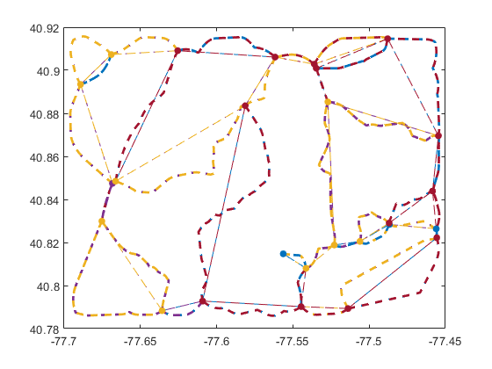
These are the stages in practice:
1) Remove through nodes
2) Remove dead ends
3) Remove through nodes

Slide 38
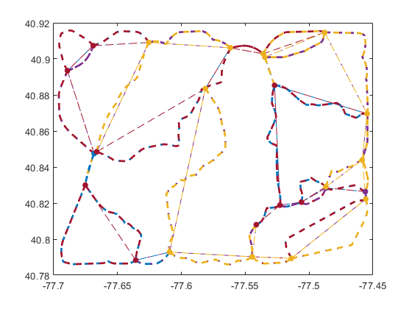
These are the stages in practice:
1) Remove through nodes
2) Remove dead ends
3) Remove through nodes
4) Remove dead ends

Slide 39
Until convergence occurs and there is one edge per corridor.

Slide 40
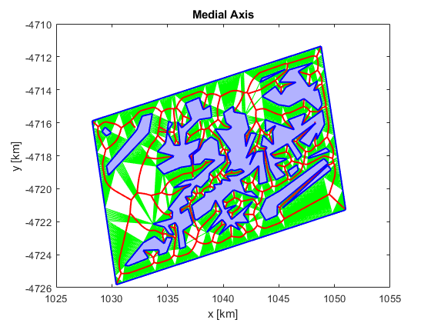
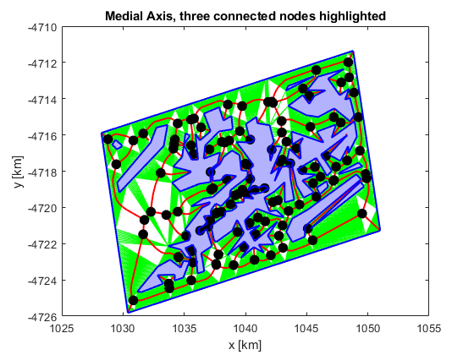
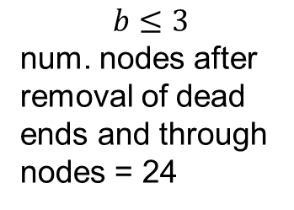
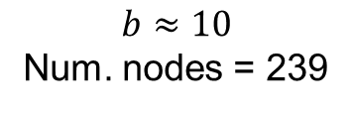
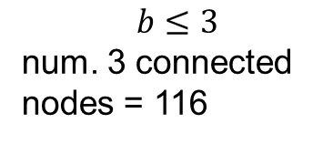
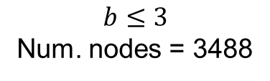
This has further reduced the number of nodes in the graph down to 10% of what was in the conventional visibility graph. And under 1% of what was in the original triangulation.
$$b≈10$$
Num. nodes = 239
$$b≤3$$
Num. nodes = 3488
$$b≤3$$
num. 3 connected nodes = 116
$$b≤3$$
num. nodes after removal of dead ends and through nodes = 24

Slide 41
Legend
Standard function
Optional function
Global input data
Global output data
Intermediate i/o data
Minimum allowed corridor, ids of denylisted triangle chains (edges)
fcn_MedialAxis_makeCostGraphAndAllPoints
Adjacency matrix, cost matrix, all points table, start data structure, finish data structure, best triangle chain (edge) between each pair of nodes
2D polytopes defined as vertices,
Triangulation resolution
fcn_MedialAxis_makeAdjacencyMatrixAndTriangleChains
Adjacency matrix, triangle chains (edges), nodes
fcn_algorithm_astar
Route (as series of nodes)
fcn_MedialAxis_pruneGraph
fcn_MedialAxis_processRoute
Adjacency matrix, triangle chains (edges), nodes (all without dead ends and “through nodes”)
Route (as series of points), route length, narrowest corridor in route
fcn_MedialAxis_addCostsToTriangleChains
Triangle chains (edges) now with lengths and corridor widths
Start position, finish position
Adjacency matrix, triangle chains (edges), nodes, triangle and node closest to start, triangle and node closest to finish
fcn_MedialAxis_addPointToAdjacencyMatrixAndTriangleChains

Slide 42
Having one edge per corridor allows for using a series of triangles along an edge to estimate corridor width.
For each triangle, TR_{i}
evaluate all 3 side lengths, {s₁, s₂, s₃}
store the maximum as the widest possible free space distance this triangle can span,
max_span(TR_{i}) = max{s₁, s₂, s₃}
End For
For each edge in the medial axis diagram (a series of triangles), E_{j} = {TR₁,…,TR_{n}}
evaluate the maximum span of each triangle in the edge,
spans_{j}={max_span(TR₁),…, max_span(TR_{n})}
store the minimum of these spans for the edge, this is the expected worst case corridor
width(Ei) = min(spans_{j})
End For

Slide 43
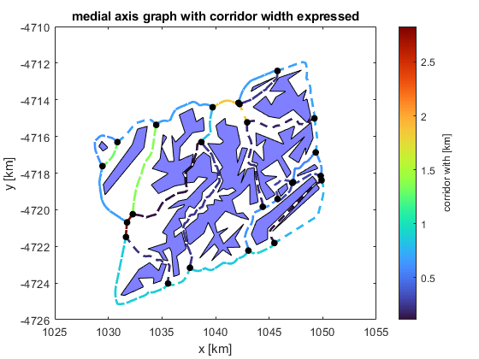
This is the result of the corridor width estimation procedure. Note, the corridors around the edge of the map are measured relative to the map bounding box and thus are not infinte.

Slide 44
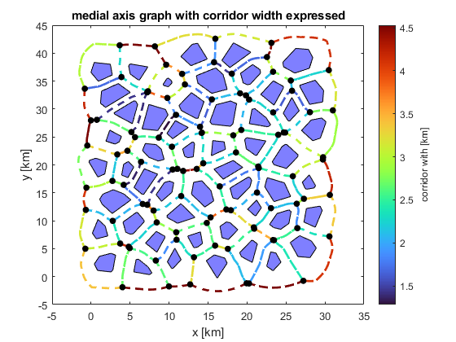
The same logic can be applied to the Halton Set maps.

Slide 45
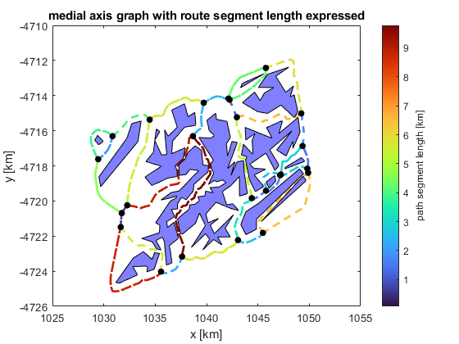
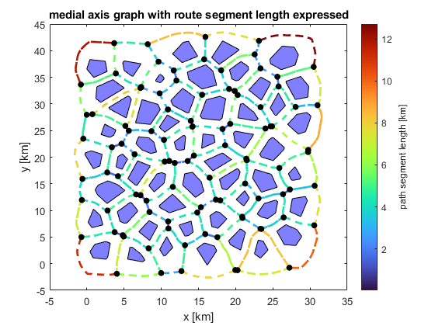
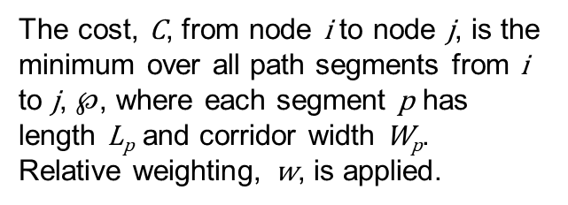
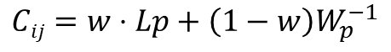
Since length is also a property of the medial axis through each corridor, we can combine length and corridor width for each graph edge into a cost.
The cost, C, from node i to node j, is the minimum over all path segments from i to j, $℘$, where each segment p has length L_{p} and corridor width W_{p}. Relative weighting, w, is applied.
$$Cij=w⋅Lp+\left(1−w\right)W_{p}^{−1}⁡$$

Slide 46
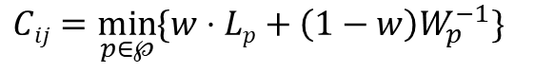
Unlike with visibility graph methods, multiple paths may exist between two nodes in the medial axis/Voronoi method. Thus we consider the minimum.
Two paths between nodes
The cost, C, from node i to node j, is the minimum over all path segments from i to j, $℘$, where each segment p has length L_{p} and corridor width W_{p}. Relative weighting, w, is applied.
$$Cij=\min_{p∈℘}{\{w⋅Lp+\left(1−w\right)W_{p}^{−1}\} }⁡$$

Slide 47
By the Bellman principle of optimality from dynamic programming, we can consider the minimum possible path, only, when multiple paths exist, as the globally optimal path, if it goes from i to j, will contain the locally optimal path from i to j.
Optimal path from i to j
i
Optimal path from A to B
B
A
j
The cost, C, from node i to node j, is the minimum over all path segments from i to j, $℘$, where each segment p has length L_{p} and corridor width W_{p}. Relative weighting, w, is applied.
$$Cij=\min_{p∈℘}{\{w⋅Lp+\left(1−w\right)W_{p}^{−1}\} }⁡$$

Slide 48
Legend
Standard function
Optional function
Global input data
Global output data
Intermediate i/o data
Minimum allowed corridor, ids of denylisted triangle chains (edges)
fcn_MedialAxis_makeCostGraphAndAllPoints
Adjacency matrix, cost matrix, all points table, start data structure, finish data structure, best triangle chain (edge) between each pair of nodes
2D polytopes defined as vertices,
Triangulation resolution
fcn_MedialAxis_makeAdjacencyMatrixAndTriangleChains
Adjacency matrix, triangle chains (edges), nodes
fcn_algorithm_astar
Route (as series of nodes)
fcn_MedialAxis_pruneGraph
fcn_MedialAxis_processRoute
Adjacency matrix, triangle chains (edges), nodes (all without dead ends and “through nodes”)
Route (as series of points), route length, narrowest corridor in route
fcn_MedialAxis_addCostsToTriangleChains
Triangle chains (edges) now with lengths and corridor widths
Start position, finish position
Adjacency matrix, triangle chains (edges), nodes, triangle and node closest to start, triangle and node closest to finish
fcn_MedialAxis_addPointToAdjacencyMatrixAndTriangleChains

Slide 49
Notice when planning through this graph, the search algorithm will find the adjacent nodes from start to finish, but the actual route follows the medial axis not the direct adjacency. Also notice the start and goal positions may be arbitrary and are snapped to the nearest medial axis position, effectively centering the route in the corridor.

Slide 50
Legend
Standard function
Optional function
Global input data
Global output data
Intermediate i/o data
Minimum allowed corridor, ids of denylisted triangle chains (edges)
fcn_MedialAxis_makeCostGraphAndAllPoints
Adjacency matrix, cost matrix, all points table, start data structure, finish data structure, best triangle chain (edge) between each pair of nodes
2D polytopes defined as vertices,
Triangulation resolution
fcn_MedialAxis_makeAdjacencyMatrixAndTriangleChains
Adjacency matrix, triangle chains (edges), nodes
fcn_algorithm_astar
Route (as series of nodes)
fcn_MedialAxis_pruneGraph
fcn_MedialAxis_processRoute
Adjacency matrix, triangle chains (edges), nodes (all without dead ends and “through nodes”)
Route (as series of points), route length, narrowest corridor in route
fcn_MedialAxis_addCostsToTriangleChains
Triangle chains (edges) now with lengths and corridor widths
Start position, finish position
Adjacency matrix, triangle chains (edges), nodes, triangle and node closest to start, triangle and node closest to finish
fcn_MedialAxis_addPointToAdjacencyMatrixAndTriangleChains

Slide 51
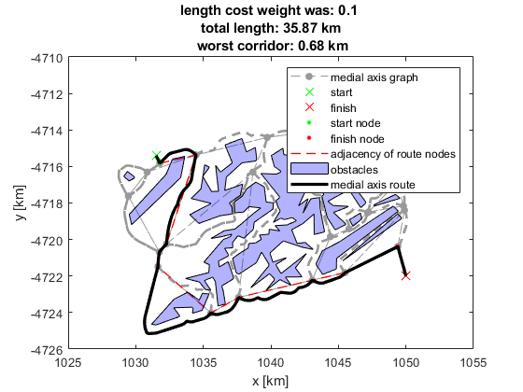
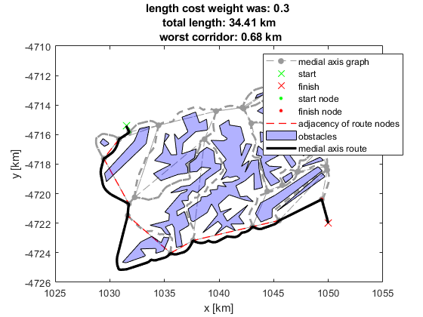
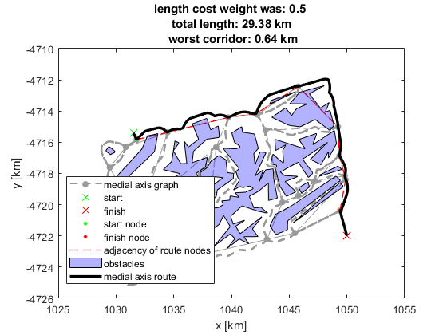
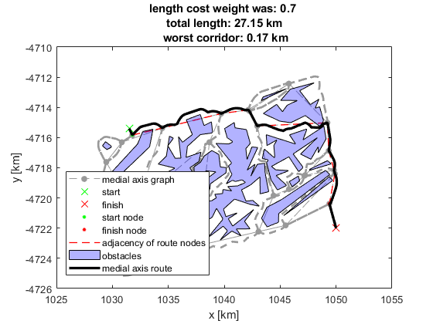
As expected, the effect of increasing the weight on length cost, relative to corridor width cost, is shorter paths at the cost of utilizing narrower corridors.
The weight on the corridor width cost function term should be selected such that the width of a typical edge is on the same scale as its length. If the width is scaled to be much larger than the length, the planner may take roundabout paths, however if the length is scaled larger than the width, the planner will not appropriately bias towards wider corridors.
Increasing priority on length reduction
Increasing priority on corridor width increasing

Slide 52

Rather than tuning the weighting, we can also produce alternate paths by filtering the graph after each planning iteration to contain only paths wider than the narrowest choke point in the prior path.

Slide 53



Rather than tuning the weighting, we can also produce alternate paths by filtering the graph after each planning iteration to contain only paths wider than the narrowest choke point in the prior path.
Iteration 1
Iteration 3
Iteration 5

Slide 54

This method is improved over the visibility graph-based alternate path plan generation as there is now only one routable edge per corridor so corridors are never reused.
Corridor used repeatedly
Old method, visibility graph-based
New method, medial axis/Voronoi-based

Slide 55
Further, the “bouncing” behavior where the planner “bounced” between walls in a corridor is eliminated as this was due to slight differences in the amount of calculated width between a visibility graph edge that laterally crossed a corridor vs one that traversed longitudinally down the corridor.
Corridor traversed laterally
Old method, visibility graph-based
New method, medial axis/Voronoi-based

Slide 56
Highlight that the alt path plan work essentially fixes the issue of "we have to dilate the field based on vehicle dynamics and go from there" now you get edge width in the map so you just filter edges that don't work during planning. no need to make a new map every time.

Slide 57


Previously, we had generated alternate paths from the initial start to the finish, both from the vgraph and the medial axis graph.
Visibility graph method
Medial axis graph method

Slide 58

With the medial axis graph, we can approach this differently, generating paths from the initial path at nodes where the motion planner may deviate during path following.

Slide 59
With the medial axis graph, we can approach this differently, generating paths from the initial path at nodes where the motion planner may deviate during path following.

Slide 60

With the medial axis graph, we can approach this differently, generating paths from the initial path at nodes where the motion planner may deviate during path following.

Slide 61
If the corridors in the initial path are forbidden when replanning, the replanned paths, regardless of where they branch off, tend to use a common alternate corridor.

Slide 62
If the corridors in the all previously calculated paths are forbidden*, greater path diversity is observed.
Ban all prior routes
*Note: within 3 segments of the finish, no option is banned to prevent the planner from being unable to reach the finish

Slide 63
This encourages behavior that resembles coverage planning in some cases. Thus a potential application would be surveying all corridors for surface properties, red team actors, solar resources, etc.

Slide 64
Replanning through the medial axis graph is faster than replanning through the visibility graph on a first pass assessment.
Replanning Method | Medial Axis | Visibility Graph
Mean time [s] | 0.0815 | 1.6334
Max time [s] | 0.1032 | 1.7734
Nodes | 106 | 313
Edges | 332 | 8610
Obstacles | 51 | 51
Ten trials of each planning method were performed. Note this is without any optimization being performed and is not an exact A-B test because of differences in the methods although the same map is used. This was for maps containing N-nodes.

Slide 65
An example of a situation that corridor width incentives could have prevented: the motion planner cannot execute a turn in the route plan.

Slide 66
Generating alternate routes from this scenario with the vgraph and medial axis graph yields the following. Notice how the turn in the original distance based vgraph route plan is not suggested in the medial axis plan nor the alternative paths generated from the vgraph.
The maneuver suggested by the original route plan that failed is shown in red.

Slide 67
One caveat is that medial axis paths can have many heading changes as they are determined by obstacle geometry, rather than visibility graph based paths which go straight except at nodes. The MPC motion planner can alleviate this by having a terminal constraint only which allows it to “jump” over sections of the reference earlier in the prediction horizon.

Slide 68
Incorporating pitch into the edge costs of a visibility graph has two challenges: (1) pitch is a function of vehicle heading and position but the sawtooth wave created by a vgraph is not the true path a vehicle would likely drive
i.e. the heading along the visibility graph edges may not be the the headings that the vehicle actually drives when path following a differentiable curve
1. Pagan, M. (2023) “Analytical Methods for High-Speed Ground Vehicle Path Planning through Obstacle Fields,” MS Thesis, The Pennsylvania State University. URL

Slide 69
Incorporating pitch into the edges of a visibility graph has two challenges: (1) pitch is a function of vehicle heading and position but the sawtooth wave created by a vgraph is not the true path a vehicle would likely drive (2) the vgraph has many edges along which pitch changes have to be analyzed

Slide 70


The Voronoi graph solves both of these problems: (1) it contains smooth paths, closer to what the vehicle would actually drive

Slide 71


The Voronoi graph solves both of these problems: (1) it contains smoother paths, closer to what the vehicle would actually drive

Slide 72
The Voronoi graph solves both of these problems: (1) it contains smooth paths, closer to what the vehicle would actually drive and (2) it contains fewer edges, along which pitch would need to be analyzed
$$b≤3$$
num. nodes after removal of dead ends and through nodes = 24
$$b≈10$$
Num. nodes = 239

Slide 73


Thus a surface with elevation data can be compactly represented in a Voronoi graph.

Slide 74

And a cost function that attempts to minimize ascending can be incorporated in to the path planner. Notice the path routes through the middle of the saddle rather than traversing the high ground.

Slide 75


Similar ascent-avoiding behavior can be observed with other maps as well, such as a paraboloid.

Slide 76
There are some barriers to porting this to 3D but it likely is possible.
A 3D triangulation forms triangles on a surface. If we triangulated the surface of free space in 3D, the triangles and their centers would be on the obstacle facets, not out in free space as far from obstacles as possible. Therefore the approximate medial axis (AMA) may not be able to be found from the triangulation in 3D as in 2D.
The Voronoi diagram also does not work to approximate the AMA in 3D although it does in 2D but algorithms exist to approximate the AMA in 3D [1]
However, the construct of the approximate medial axis, is expected to also work for planning far away from obstacles in 3D [2]
It may require a different way of being computed, based on an extensions of the algorithms for finding the Voronoi diagram [3] and AMA [4] in 2D.
In 2D, we use a constrained Delaunay triangulation to distinguish between triangles in objects and triangles outside objects. MATLAB does not have this constrained capability for 3D so it would need to be developed.
[1] Dey, Tamal K., and Wulue Zhao. "Approximating the medial axis from the Voronoi diagram with a convergence guarantee." Algorithmica 38 (2004): 179-200.
[2] Masehian, Ellips, and M. R. Amin‐Naseri. "A voronoi diagram‐visibility graph‐potential field compound algorithm for robot path planning." Journal of Robotic Systems 21.6 (2004): 275-300.
[3] F. Aurenhammer and R. Klein, Voronoi diagrams, inHandbook of computational geometry, edited by J.Sack and G. Urrutia, Elsevier Science, Amsterdam,2000.
[4] E. Masehian, M.R. Amin-Naseri, and S. EsmaeilzadehKhadem, Online motion planning using incremental construction of medial axis, in Proc of IEEE Int Confon Robotics and Automation (ICRA 2003), September2003, Taiwan, pp. 2928–2933.

